Slide 1

PREDICTIVE ANALYTICS
Practical: Filter Node – Keeping, Removing and Renaming Fields
PRESENTED BY
Priyanshi
Akhilesh Mishra
Kumar Vaibhav
PRESENTED TO
Mr. Ferhan Ahmed
IBM Trainer
United University

Slide 2
Practical Idea & Objective
Purpose of the practical
Idea: Prepare an employee dataset by selecting useful fields.
Use the Filter Node to keep required columns and remove unnecessary columns.
Understand how fields can be renamed for clearer labels.
Check the final table to confirm the required fields and records remain.

Slide 3
Introduction to Predictive Analytics
Predictive Analytics uses historical data to estimate possible future outcomes.
It supports forecasting, planning, and business decisions.
Data preparation is an important step before building predictive models.
Our Filter Node practical prepares fields; the node itself does not make predictions.

Slide 4
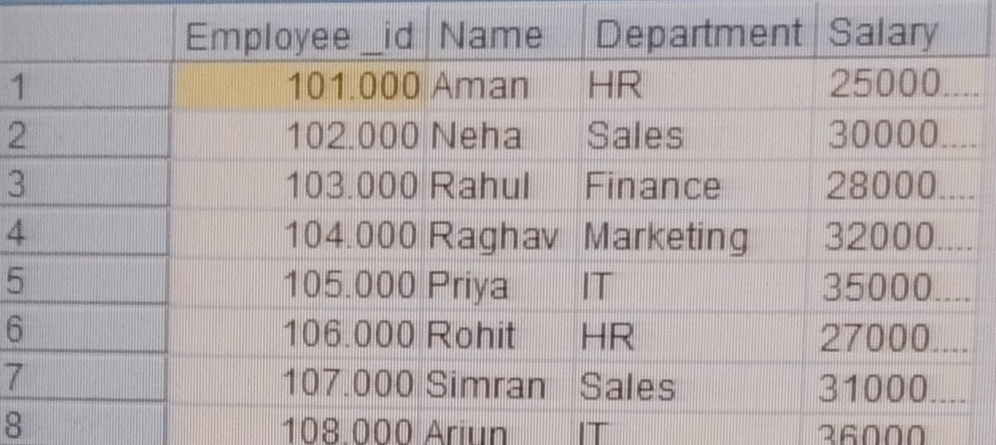
Employee Dataset
Input data used in the practical

Slide 5
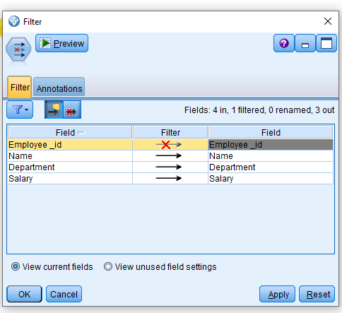
Application OF : Filter Node

Slide 6
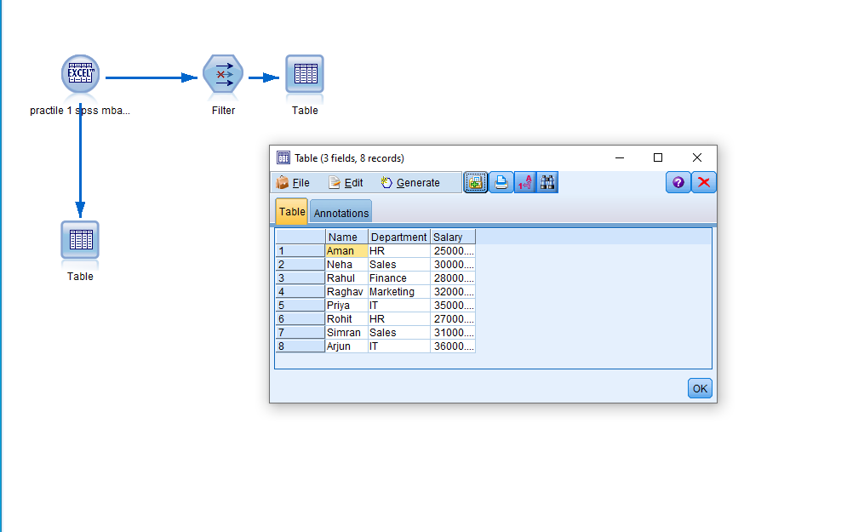
Practical Output
Filtered table: 3 fields and 8 records

Slide 7
Procedure & Filter Operations
Import the employee dataset into the workflow.
Connect the dataset to the Filter Node.
Keeping: retain only the fields needed for analysis.
Removing: exclude unnecessary fields, such as Employee_id in this output.
Renaming: change a field name when a clearer label is required.
Run the workflow and inspect the output table.

Slide 8
Conclusion & Learning Outcomes
The Filter Node helped simplify the employee dataset.
Employee_id was removed; Name, Department, and Salary were retained.
The output contained 3 fields and 8 records.
This practical demonstrates data preparation for further analysis, not prediction itself.

Slide 9


